Slide 1
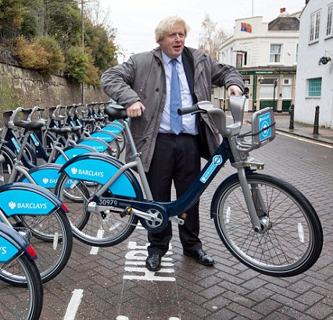
Should we cycle there?
Optimising TfL’s bike redistribution strategy

Slide 2
Background
The Dataset
TfL bike rental usage data
5 years worth of data, with every journey tracked (2GB)
Data recorded:
Start and end locations
Start and end times
Duration of cycle
Bike Id
The Problem
Arrivals and depatures don’t balance, leading to either no bikes or no parking spots.
Vans are needed to redistribute bikes to avoid full or empty stations.
Can we come up with a strategy to optimise this?
The Tools
Analysis is performed on the amazing ASI cloud platform, SherlockML.
Data is read in and summarised using pandas.
Visualisation using matplotlib.
Simulations using custom scripts.

Slide 3
Most trips occur during on weekdays
Total trips peak mid week, and drop off on the weekends.
Weekday trips have the same duration, while weekend trips are longer.

Slide 4
Warmer months are more popular
Most trips occur in Summer.
Average trip duration is higher in warmer months.

Slide 5
Fewer people cycle in the rain
Examining the correlation of trips at peak times on weekdays shows some correlation with total rainfall
However the relationship is quite weak

Slide 6
Trips massively peak during the rush hours
Trip frequency depends massively on the time of day.
For some reason, people at 2am take much longer trips. The reasons why are unclear…

Slide 7
Differences in traffic flows lead to shortages

Slide 8
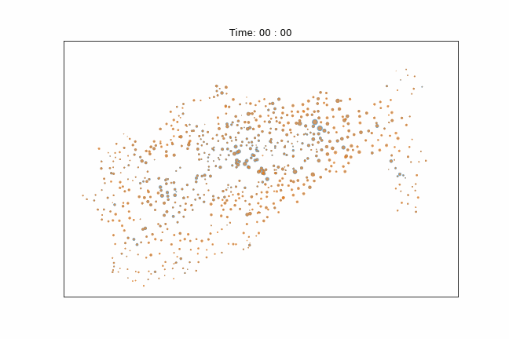
Differences in traffic flows lead to shortages
Each dot is a station.
Blue dots show departures.
Orange dots show arrivals.
The size of the dot shows the amount,.
Kings X
Hyde Park
Canary Wharf
Waterloo

Slide 9
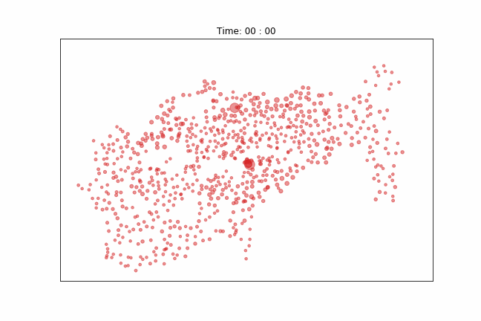
Differences in traffic flows lead to shortages
Each dot is a station.
The size of the dot shows the amount of bikes at the station.
Bikes flow inward in the morning, outwards in the evenings.

Slide 10
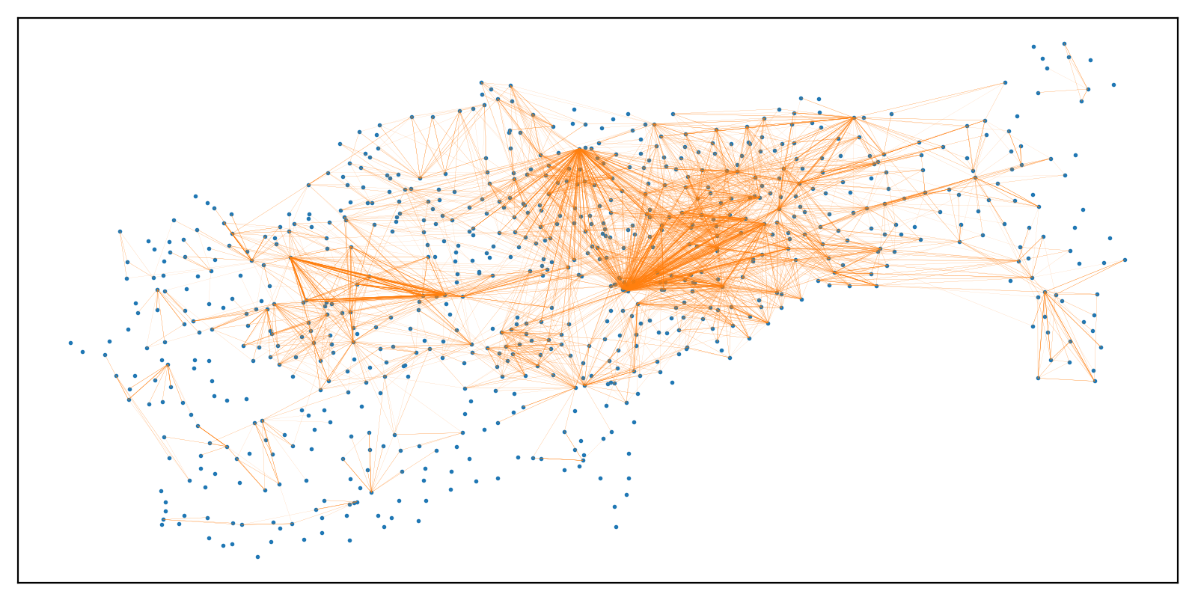
There are several key stations for journeys
The width of the line is proportional to the number of journeys between the two stations.

Slide 11
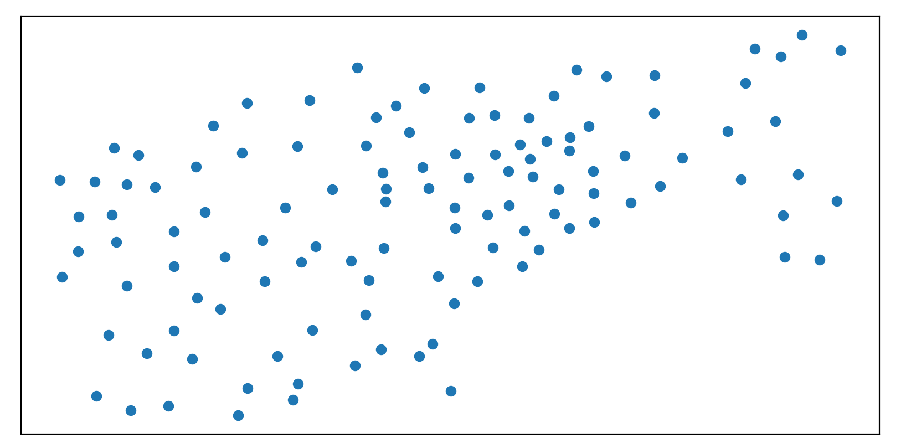
Clustering
To simplify the analysis and simulation we cluster stations according to their TFL assigned cluster name.
The (net flow / cluster capacity) within the rush hours can be compared to highlight the clusters most in need to cycle redistribution.

Slide 12
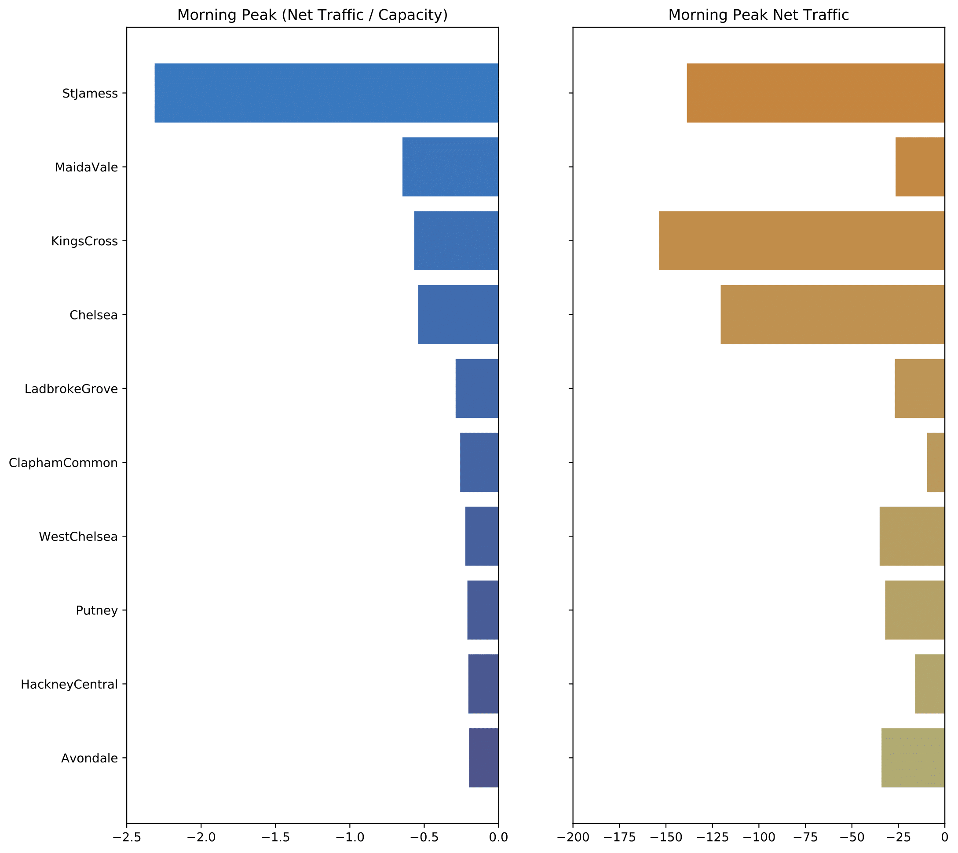
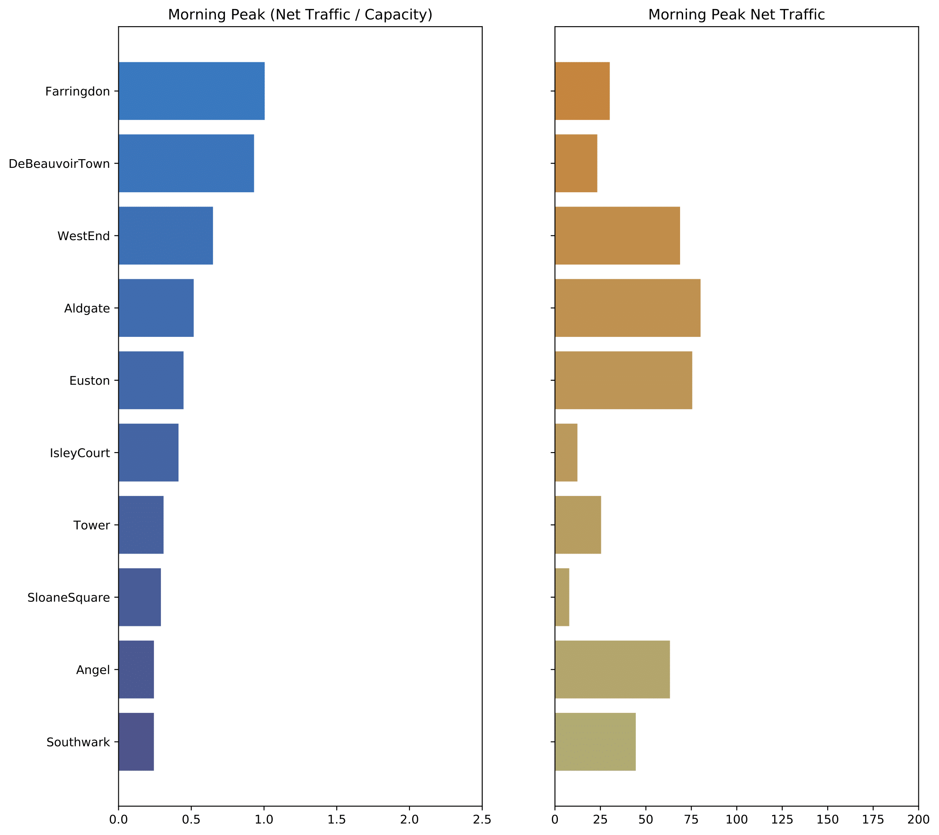
Morning Rush Hours (07:00 -to 10:00)

Slide 13
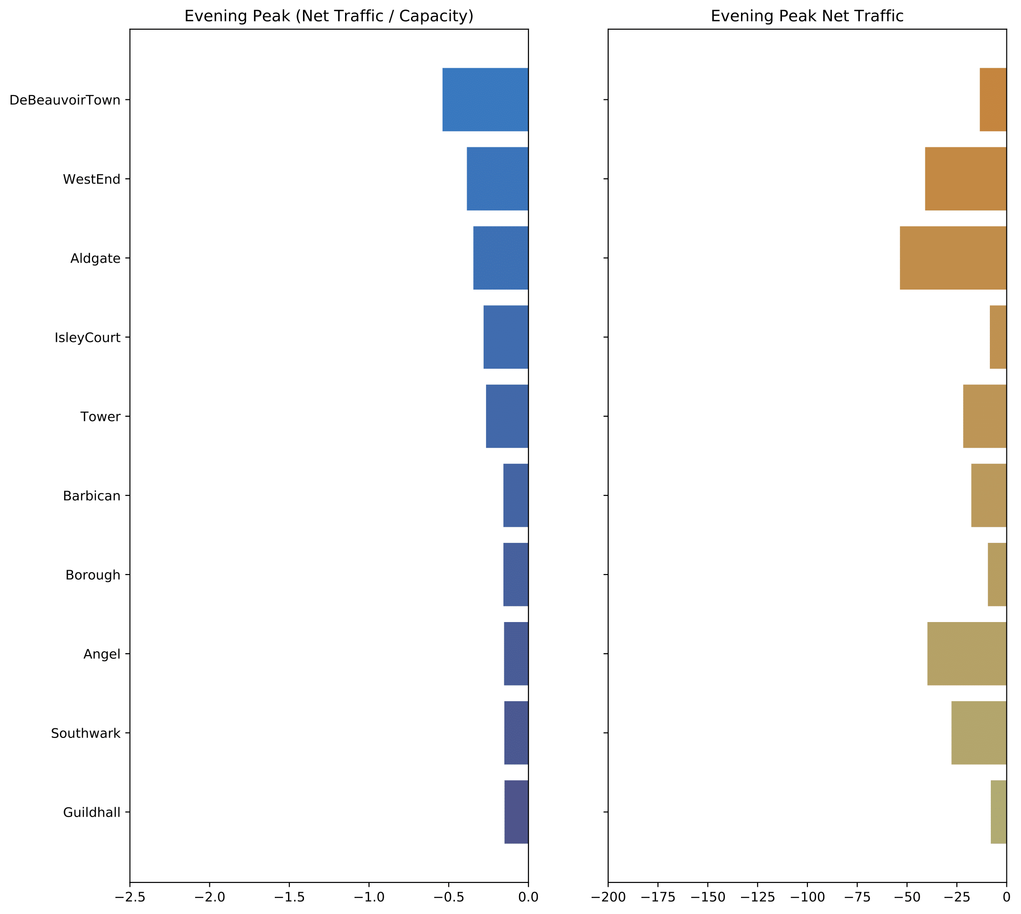
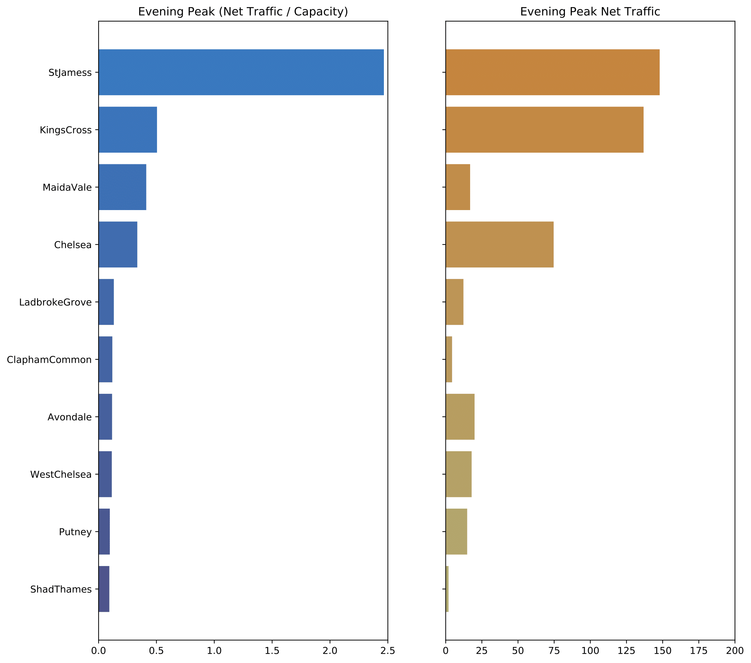
Evening Rush Hours (16:00 to 19:00)

Slide 14
Current Redistribution Strategy
Text here

Slide 15
Simulating deliveries
The simulation
TfL bike rental usage data
5 years worth of data, with every journey tracked (2GB)
Data recorded:
Start and end locations
Start and end times
Duration of cycle
Bike Id
Key assumptions
Drivers work hard, and don’t play at all.
Vans are always in use.

